Slide 1
HOSPITALIA HEALTH & WELLNESS
Patient Experience Analytics Project
NPS-Driven Healthcare Performance & Profitability Study
Amr Zaki
Data Cleaning & Modeling, SQL, Power BI
Omnia Magdy
Tableau Dashboards & Presentation
Rawan Mahmoud
Data Analysis, Excel Dashboard, Python, Documentation
Fatma Ali
Excel Statistics & Descriptive Analysis, Power BI
Mostafa Samir
Helped in insights
Prepared by Dr. Amal Mahmoud | Academic Year 2024-2025 | Care · Compassion · Excellence

Slide 2
Presentation Agenda
01
02
03
Project Overview and Why We Selected It
4W's and How's and Data Exploration
Project Summary (Data Cleaning, Outlier Treatment, Feature Engineering, Descriptive Statistics, Data Modeling, Insights Derived, Dashboards)
04
05
06
Excel
SQL
Python
07
08
09
Power BI
Tableau
Final Insights

Slide 3

Project Overview
Dataset Information
Total Records
Time Period
Hospital Branches
10,000 patient-level survey records
2024-2025
4 branches (Central, North, South, East, West)
Departments
Columns
8 departments
20+ attributes including NPS Score, Waiting Time, Doctor Rating, Treatment Cost, etc.
Project Context
Hospitalia Health & Wellness is a multi-branch hospital network that identified declining Net Promoter Score (NPS) and its correlation with reduced profitability. This project aims to:
Identify root causes of NPS decline
Quantify correlation between NPS and profitability
Profile patient segments and satisfaction patterns
Deliver interactive dashboards for decision-making
Why We Selected This Project
Our team has extensive experience in customer satisfaction analytics and healthcare operations. This project is the best fit because:
Directly addresses critical business challenge (NPS decline)
Combines operational and financial metrics
Requires comprehensive data pipeline (cleaning, modeling, visualization)
Provides actionable insights for hospital management

Slide 4
What Happened? - Business Problem
The Hospital Noticed:
Customer satisfaction started declining
Net Promoter Score (NPS) decreased in the second year
Profitability also dropped with the decline in patient experience
Key Findings:
Average NPS decreased from 44.12 in 2024 to 43.45 in 2025.
Total profit decreased from 10.25M to 10.17M.
1.5%
0.8%
Decline in NPS
Decline in Profit
This represents a 1.5% decline in NPS.
This represents a 0.8% decline in profit.
Business Insight:
The data suggests that declining patient experience directly impacted hospital profitability.

Slide 5
Why Did It Happen? - Root Cause Analysis
We discovered several operational factors strongly connected with lower NPS.
Strong Negative Drivers (Factors that REDUCE NPS):
Strong Positive Drivers (Factors that INCREASE NPS):
Waiting Time: Strong Negative Correlation (-0.75)
Appointment Delay: Negative Correlation (-0.55)
Complaint Count: Negative Correlation (-0.33)
Service Rating: Strong Positive Correlation (+0.79)
Doctor Rating: Positive Correlation (+0.59)
Staff Rating: Positive Correlation (+0.49)
Cleanliness Rating: Positive Correlation (+0.32)
Main Insight: The strongest factor affecting NPS was service quality and waiting experience.

Slide 6
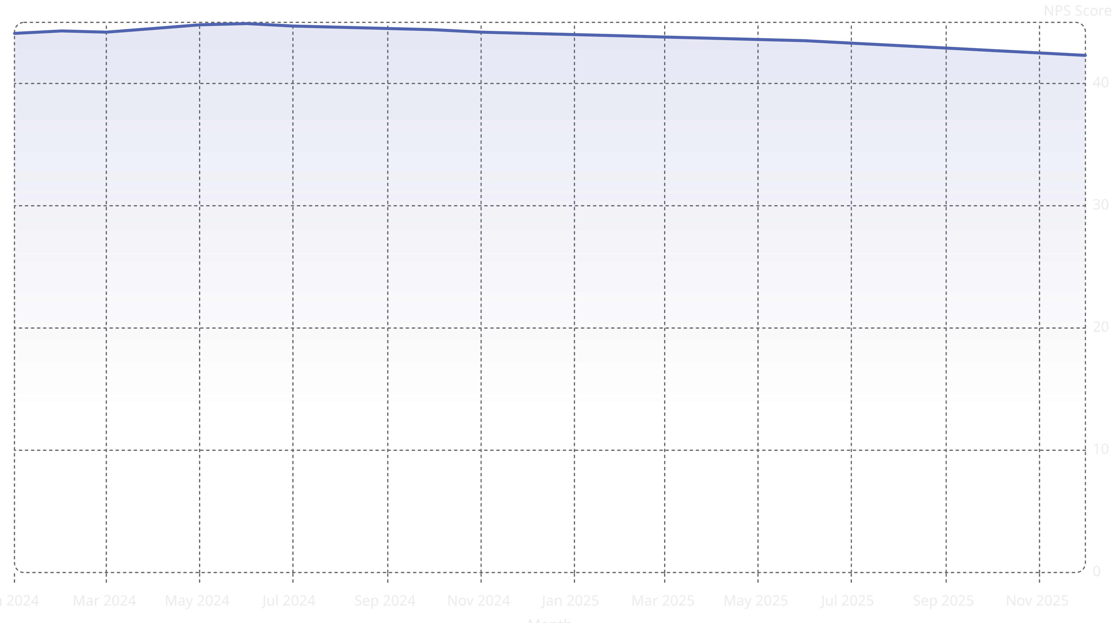
When Did It Happen? - NPS Trend Over Time
Trend Analysis:
NPS performance declined during 2025 compared to 2024
The decline aligned with:
Increased waiting times
Higher appointment delays
More operational pressure on services
Business Interpretation:
Operational inefficiencies increased over time, reducing patient satisfaction and affecting profitability.
The line chart illustrates the monthly Net Promoter Score trend from January 2024 to December 2025, clearly showing a decline in NPS, particularly during the latter half of 2025.

Slide 7
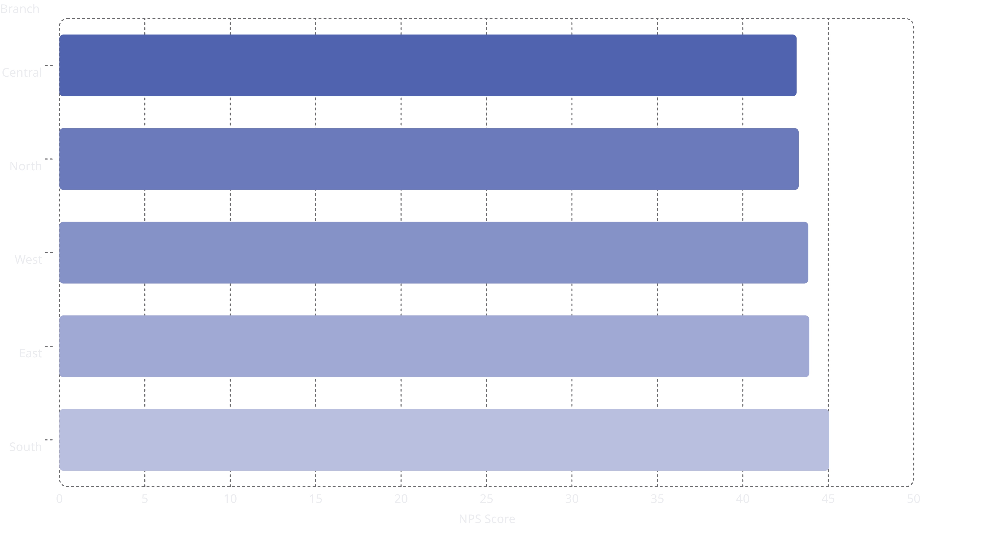
Where Did It Happen? - Branch Performance Analysis
Lowest Performing Branches by NPS:
Central: 43.15
North: 43.27
West: 43.83
Highest Performing Branches:
South: 45.05
East: 43.89
Key Insight: Branch performance differences suggest that operational quality and patient experience vary significantly by location.

Slide 8
Project Summary
Data Cleaning
Fixed data types (converted dates, standardized numeric formats)
Standardization (strip(), title() applied to categorical columns)
Removed duplicates (kept most recent visit per patient)
Handled missing data (imputed with median/mode)
Outlier Treatment
Applied IQR capping method
Capped 87 NPS outliers, 322 lifetime value outliers, 39 waiting time outliers, etc.
Preserved original values in backup
Feature Engineering
Created Age Band categories (Children, Teens, Young Adults, Middle-Aged, Seniors)
Derived temporal features from Survey Date (Year, Month, Quarter)
Created NPS_Category (Promoter/Passive/Detractor)
Calculated Overall_Rating composite metric
Descriptive Statistics
Computed mean, std dev, min, median, max for all numeric variables
Analyzed skewness and kurtosis
Categorical summaries for all text fields
Data Modeling
Built Star Schema with 5 Dimension tables and 1 Fact table
Dimension tables: Patient, Visit, Department, Hospital Branch, Service, Date
Fact table: Healthcare transactions with all KPIs
Dashboards Created
Excel: 3 interactive dashboards with filters
Power BI: 3 dashboard pages (Satisfaction, Drivers, Performance)
Tableau: 3 views with drill-down capabilities
Python: 3 visualization dashboards

Slide 9
Excel: Data Modeling & Descriptive Statistics
Descriptive Statistics Summary Table
Metric
Mean
Std Dev
Min
Median
Max
Age
37.45
21.18
0
37
90
Waiting Time
35.25
14.63
5
35
75
NPS Score
43.87
23.40
-19
46
100
Doctor Rating
4.53
0.56
2.5
5
5
Treatment Cost
4424.80
1535.81
1168.23
4301.72
8992.58
Excel Dashboards
Dashboard 1: Satisfaction Metrics
Dashboard 2: Operational Drivers
Dashboard 3: Performance Analysis
[Space Reserved for Upload]
[Space Reserved for Upload]
[Space Reserved for Upload]

Slide 10
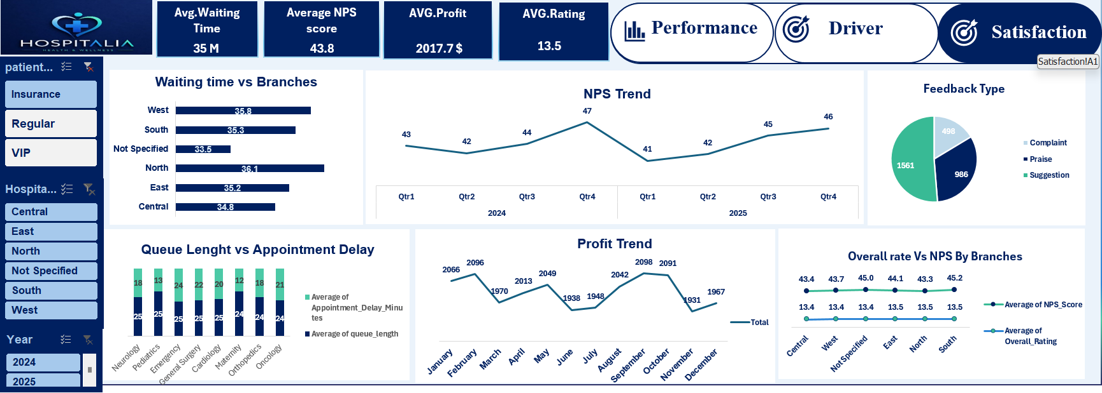

Slide 11
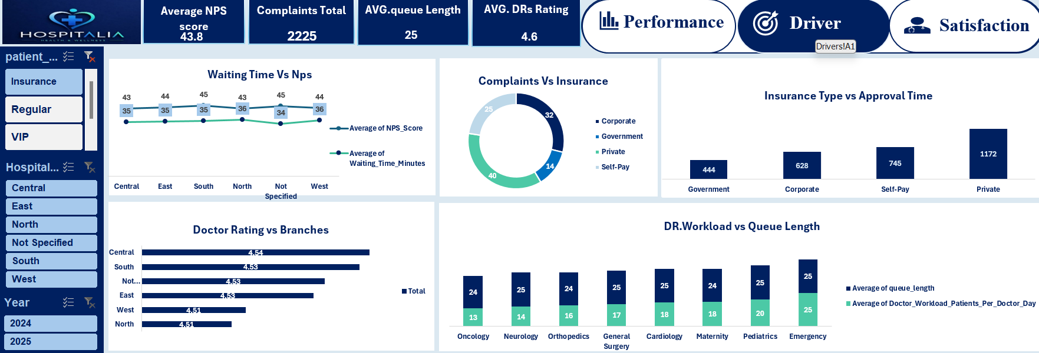

Slide 12
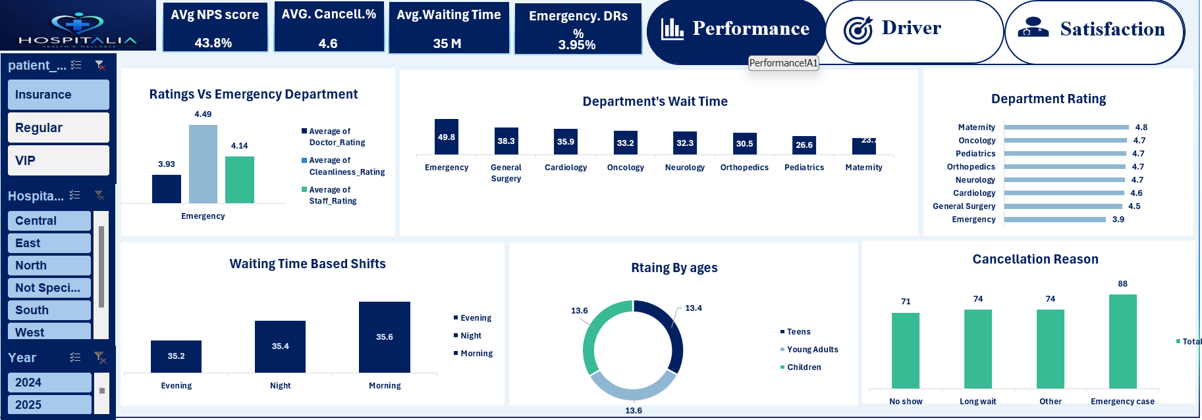

Slide 13
SQL: Key Steps
Key Data Cleaning & Preprocessing Steps:
01
02
03
Type Fixing & Standardization
Deduplication
Missing Value Imputation
Converted Survey_Date from Excel serial to datetime
Cast numeric columns to correct float/int types
Applied strip(), title(), lower() to categorical columns
Standardized Hospital_Branch, Insurance_Type, Gender, Service_Shift
Sorted by Survey_Date descending
Dropped duplicate Patient_ID entries (kept most recent)
Removed entirely identical rows
Validated row count before/after
Imputed numeric values with column median
Imputed categorical values with mode
Preserved distribution shape
04
05
Outlier Treatment (IQR Capping)
Feature Engineering
Applied IQR method to identify outliers
Capped values outside [Q1 - 1.5×IQR, Q3 + 1.5×IQR]
Documented outlier counts per column
Extracted Year, Month, Quarter from Survey_Date
Created NPS_Category (Promoter/Passive/Detractor)
Derived Age_Group categories
Calculated Overall_Rating composite

Slide 14
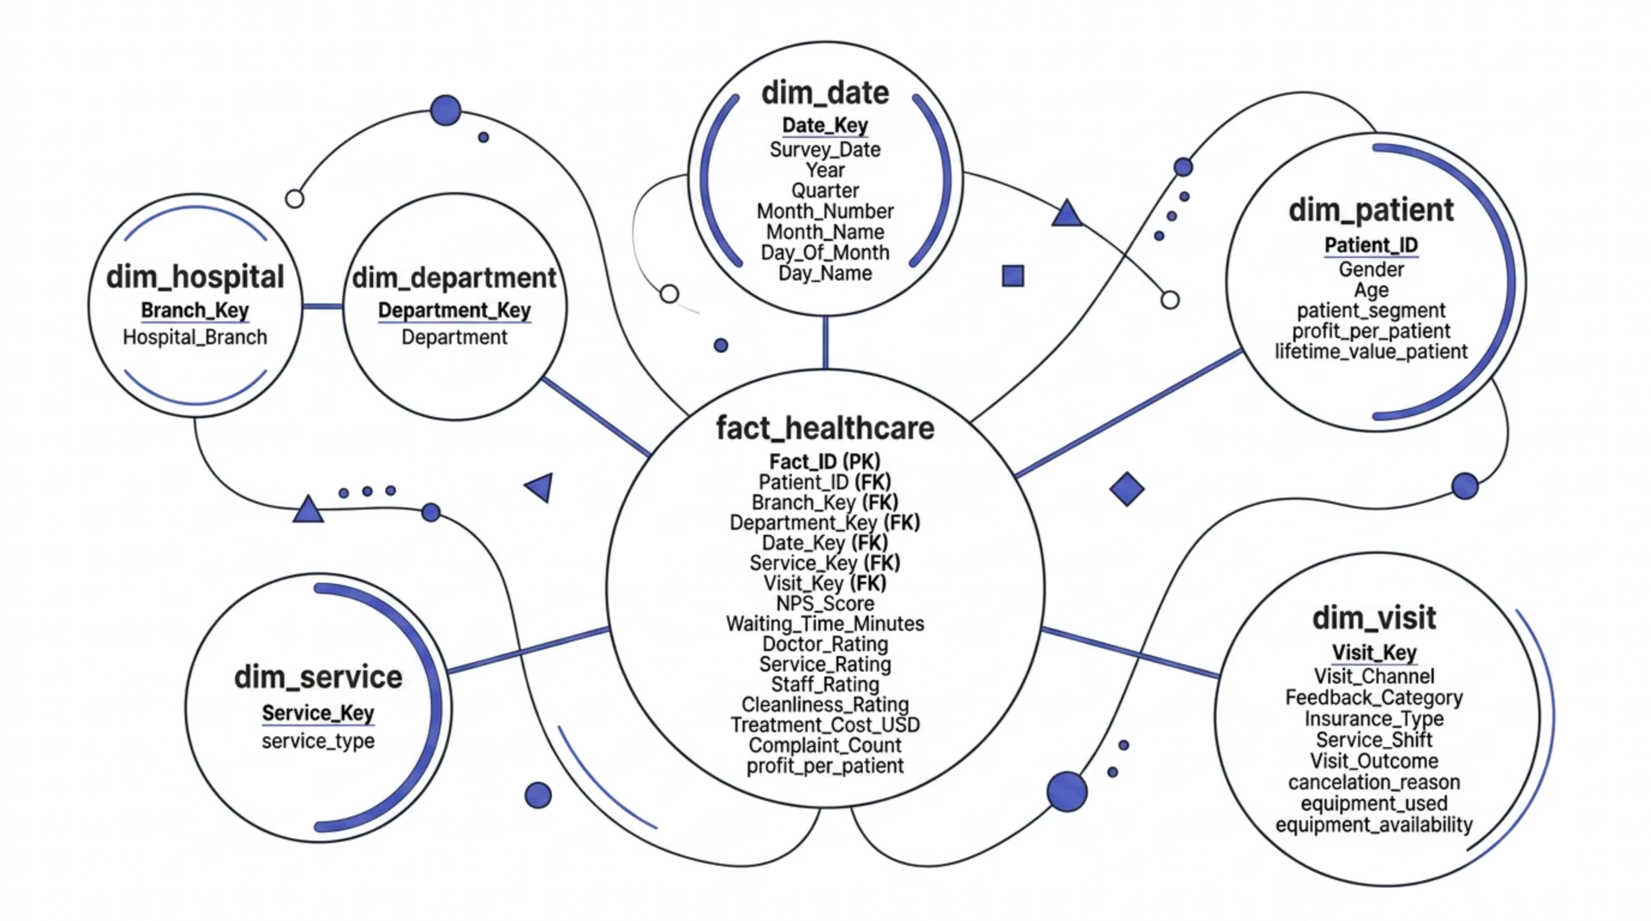

SQL: Star Schema & ERD
The ERD illustrates the normalized star schema with 1 Fact table and 5 Dimension tables.
Here are the details of the tables:
Fact Table: fact_healthcare
Fact_ID (Primary Key)
Patient_ID (Foreign Key)
Branch_Key (Foreign Key)
Department_Key (Foreign Key)
Date_Key (Foreign Key)
Service_Key (Foreign Key)
Visit_Key (Foreign Key)
Key metrics: NPS_Score, Waiting_Time_Minutes, Doctor_Rating, Service_Rating, Staff_Rating, Cleanliness_Rating, Treatment_Cost_USD, Complaint_Count, profit_per_patient
Dimension Tables:
dim_patient: Patient_ID, Gender, Age, patient_segment, profit_per_patient, lifetime_value_patient
dim_hospital: Branch_Key, Hospital_Branch
dim_department: Department_Key, Department
dim_date: Date_Key, Survey_Date, Year, Quarter, Month_Number, Month_Name, Day_Of_Month, Day_Name
dim_service: Service_Key, service_type
dim_visit: Visit_Key, Visit_Channel, Feedback_Category, Insurance_Type, Service_Shift, Visit_Outcome, cancelation_reason, equipment_used, equipment_availability
The diagram visually represents the star schema structure, highlighting the central fact table and its connections to the various dimension tables through foreign keys.

Slide 15
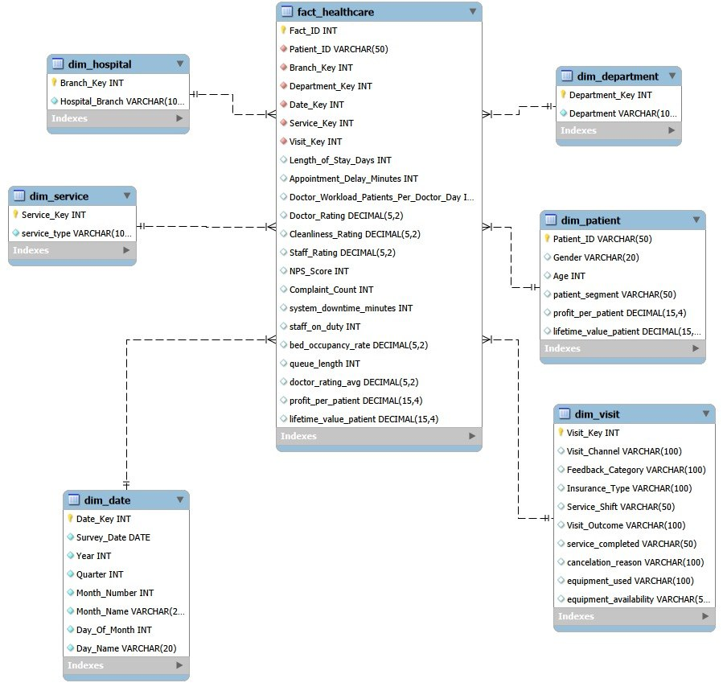

Slide 16
Python: Dashboard 1 - Satisfaction Metrics
Key Metrics Displayed:
Average NPS Score: 43.87
Average Waiting Time: 35.25 minutes
Average Profit per Patient: $2,013.11
Average Overall Rating: 4.30/5
Visualizations:
NPS Trend Over Time (Line Chart): Shows monthly NPS from 2024-2025 with clear downward trend in Q4 2025
Waiting Time vs Branches (Bar Chart): Compares average waiting times across all 5 branches
Queue Length vs Appointment Delay (Stacked Bar): Shows relationship between queue metrics and delays
Profit Trend (Line Chart): Monthly profit trend aligned with NPS decline
Overall Rating vs NPS by Branch (Scatter): Shows correlation between overall satisfaction and NPS
[Python Dashboard 1 - Satisfaction Metrics Visualization]

Slide 17
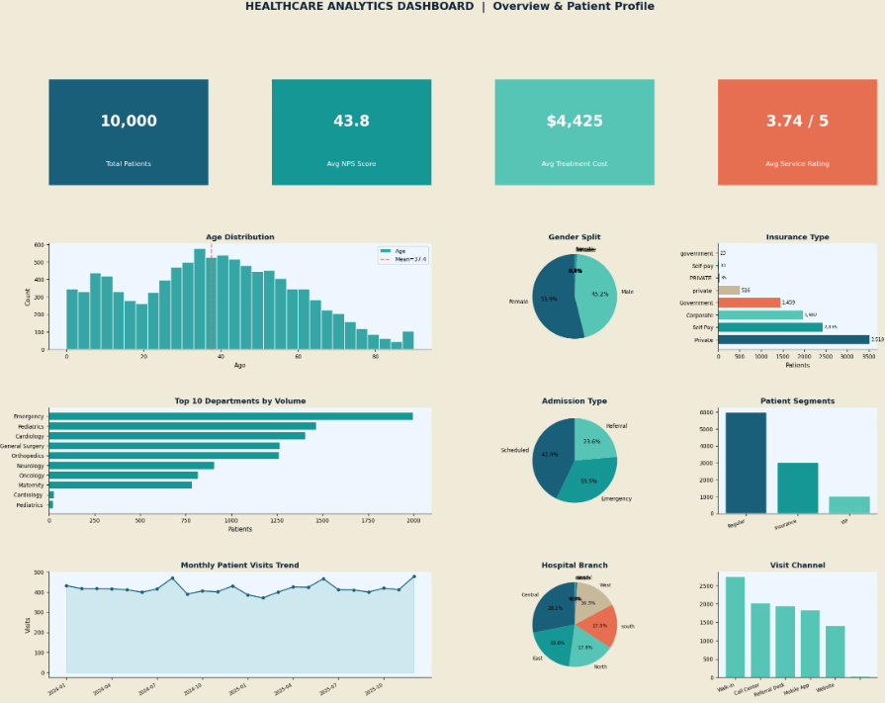

Slide 18
Python: Dashboard 2 - Operational Drivers
Key Metrics Displayed:
Average NPS Score: 43.87
Total Complaints: 2,225
Average Queue Length: 24.51 patients
Average Doctor Rating: 4.53/5
Visualizations:
Waiting Time vs NPS Correlation (Scatter Plot): Shows strong negative correlation (-0.75) between waiting time and NPS
Complaints vs Insurance Type (Bar Chart): Private insurance generates most complaints (858), followed by Self-Pay (542)
Doctor Rating vs Branches (Bar Chart): Shows consistent doctor quality across branches (4.52-4.54)
Doctor Workload vs Queue Length (Grouped Bar): Emergency department has highest combined workload
Waiting Time vs Department (Horizontal Bar): Emergency department (49.2 min) is critical bottleneck
[Python Dashboard 2 - Operational Drivers Visualization]

Slide 19
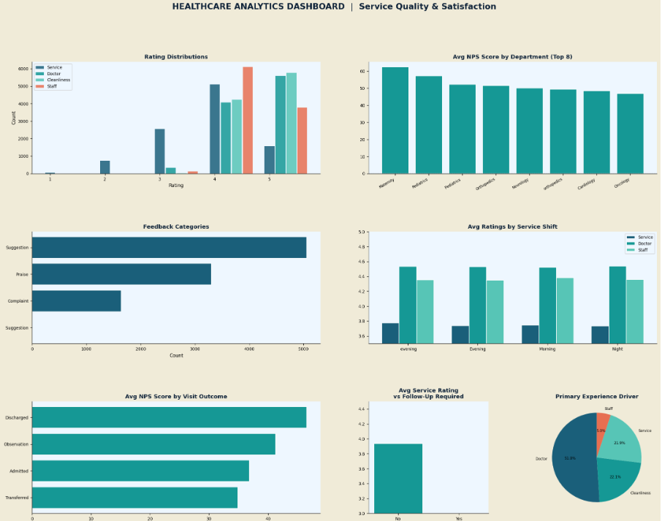

Slide 20
Python: Dashboard 3 - Performance Analysis
Key Metrics Displayed:
Average NPS Score: 43.87
Total Complaints: 2,225
Average Waiting Time: 35 minutes
Average Doctor Rating: 4.53/5
Visualizations:
Patient Distribution by Insurance (Pie Chart): Regular 59.7%, Insurance 30.2%, VIP 10.1%
Performance by Admission Type (Bar Chart): Scheduled (48.8), Referral (47.84), Emergency (34.25)
Profit by Admission Type (Pie Chart): Emergency 33.33%, Referral 33.33%, Scheduled 33.33%
Patients by Visit Channel (Bar Chart): Walk-in (2,740), Call/Checkin (2,100), Referral/Walk-in (2,000), Mobile/Walk-in (1,800), Website (1,400)
Average Rating by Department (Horizontal Bar): Maternity (10.9), Orthopedics (10.8), Pediatrics (10.8), Neurology (10.7), Oncology (10.7), Cardiology (10.6), General Surgery (10.4), Emergency (9.9)
[Python Dashboard 3 - Performance Analysis Visualization]

Slide 21
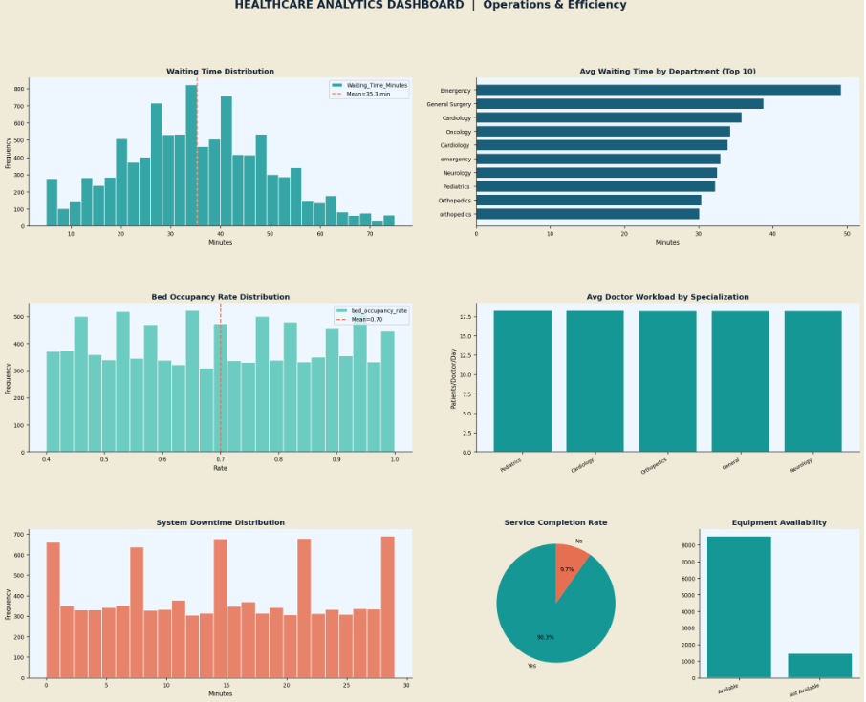

Slide 22
Power BI: Dashboard 1 - Satisfaction Overview
Key Metrics Displayed:
43.8
35
Average NPS Score
Average Waiting Time
minutes
$2.0K
10.5
Average Profit
Average Overall Rating
Visualizations:
Performance Tabs: Three tabs showing Satisfaction, Driver, and Performance metrics
Waiting Time vs Branches (Bar Chart): Shows performance across Central, East, North, South, West branches
Queue Length vs Appointment Delay (Stacked Bar): Relationship between queue metrics
Doctor Rating Distribution (Pie Chart): Distribution of doctor ratings
NPS Trend (Line Chart): Monthly trend from 2024-2025
Feedback Type (Pie Chart): Complaint, Praise, Negative distribution
Filters Available:
Patient Segment (Insurance, Regular, VIP)
Hospital Branch (Central, East, North, South, West)
Year (2024, 2025)
[Power BI Dashboard 1 - Satisfaction Overview]

Slide 23
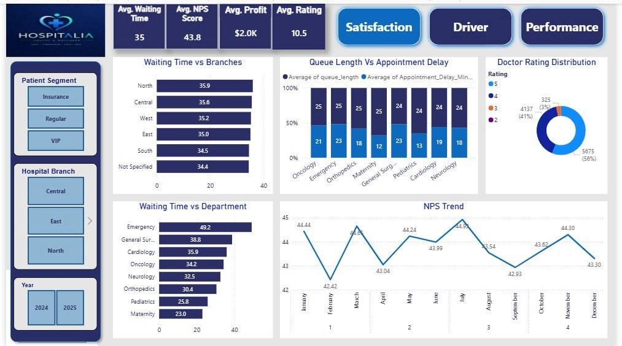

Slide 24
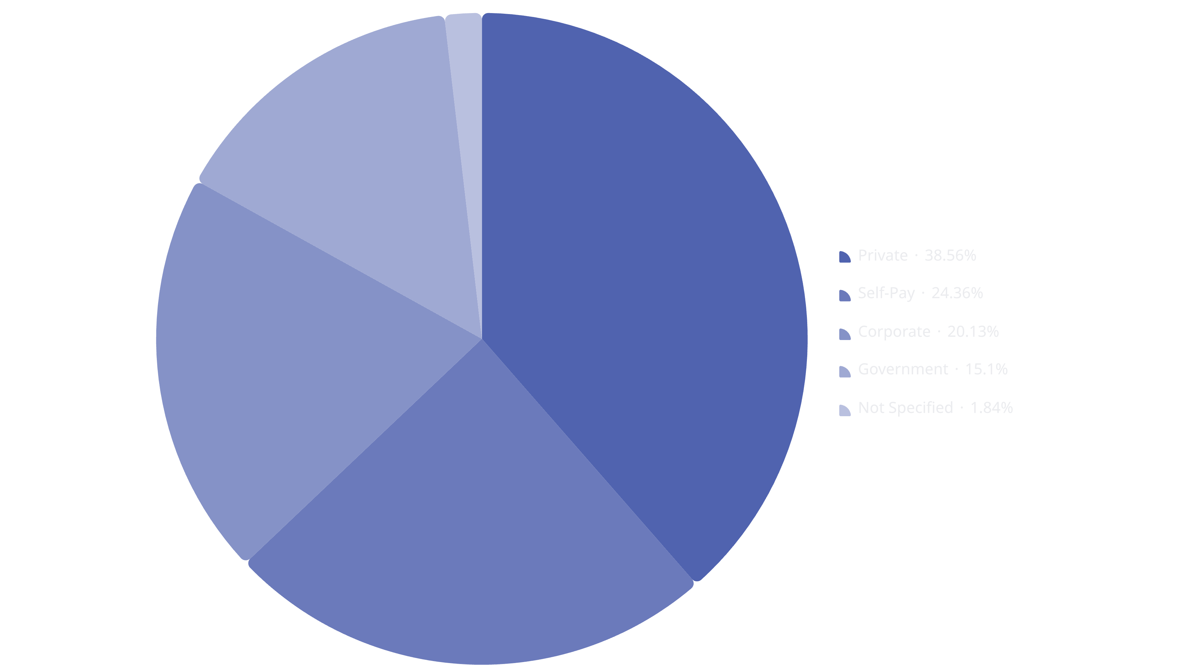
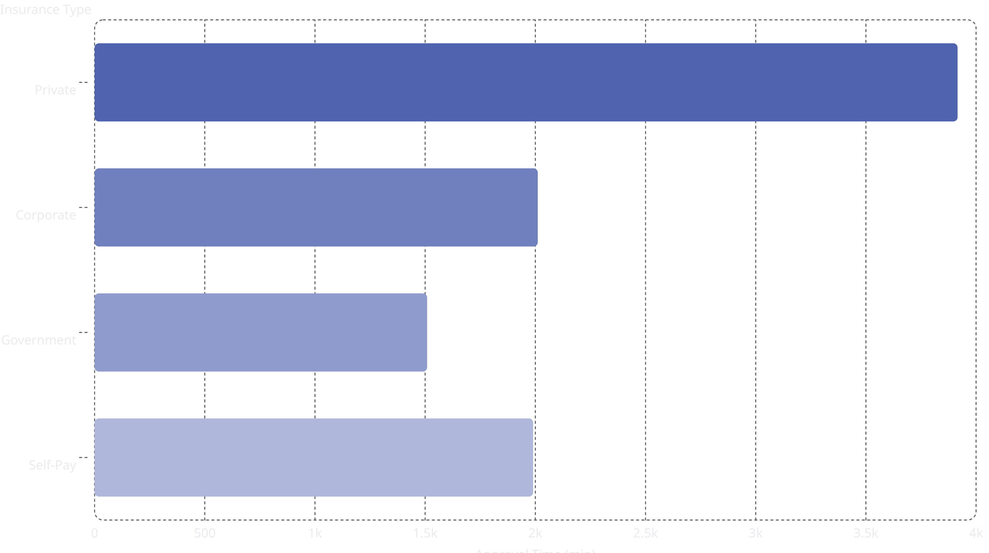
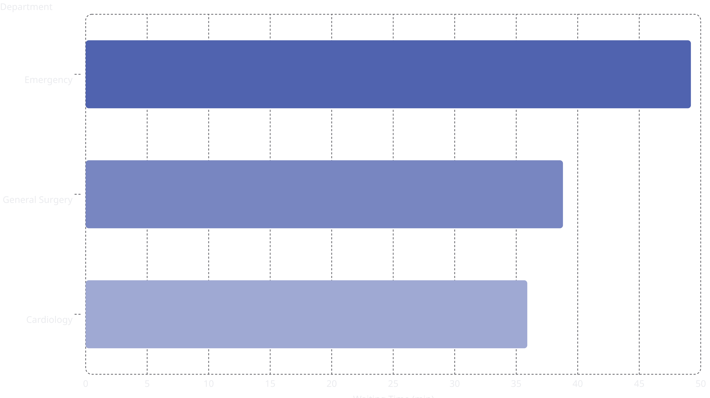
Power BI: Dashboard 2 - Drivers & Insights
Key Metrics Displayed:
43.8
2225
Average NPS Score
Total Complaints
25
4.6
Average Queue Length
Average Doctor Rating
Visualizations:
The pie chart shows the distribution of complaints by insurance type, highlighting that private insurance generates the most complaints.
This bar chart compares the average approval time across different insurance types, indicating that private insurance has the longest approval time.
The horizontal bar chart highlights waiting times by department, showing Emergency as having the longest wait.
Waiting Time vs NPS (Scatter Plot): Shows strong negative correlation
Complaints vs Insurance (Pie Chart): Private (858), Self-Pay (542), Corporate (448), Government (336), Not Specified (41)
Insurance Type vs Approval Time (Bar Chart): Private (3916 min), Corporate (2011 min), Government (1509 min), Self-Pay (1990 min)
Doctor Rating vs Branches (Bar Chart): Consistent ratings across all branches
Doctor Workload vs Queue Length (Grouped Bar): Emergency department highest workload
Waiting Time vs Department (Horizontal Bar): Emergency (49.2), General Surgery (38.8), Cardiology (35.9), etc.
Filters Available:
Patient Segment (Insurance, Regular, VIP)
Hospital Branch (Central, East, North, South, West)
Year (2024, 2025)
[Power BI Dashboard 2 - Drivers & Insights]

Slide 25
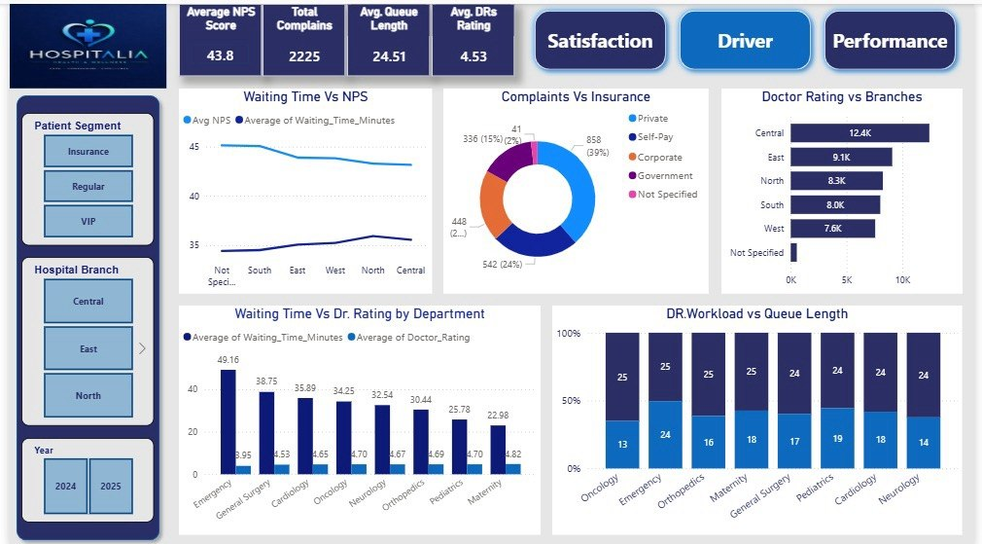

Slide 26
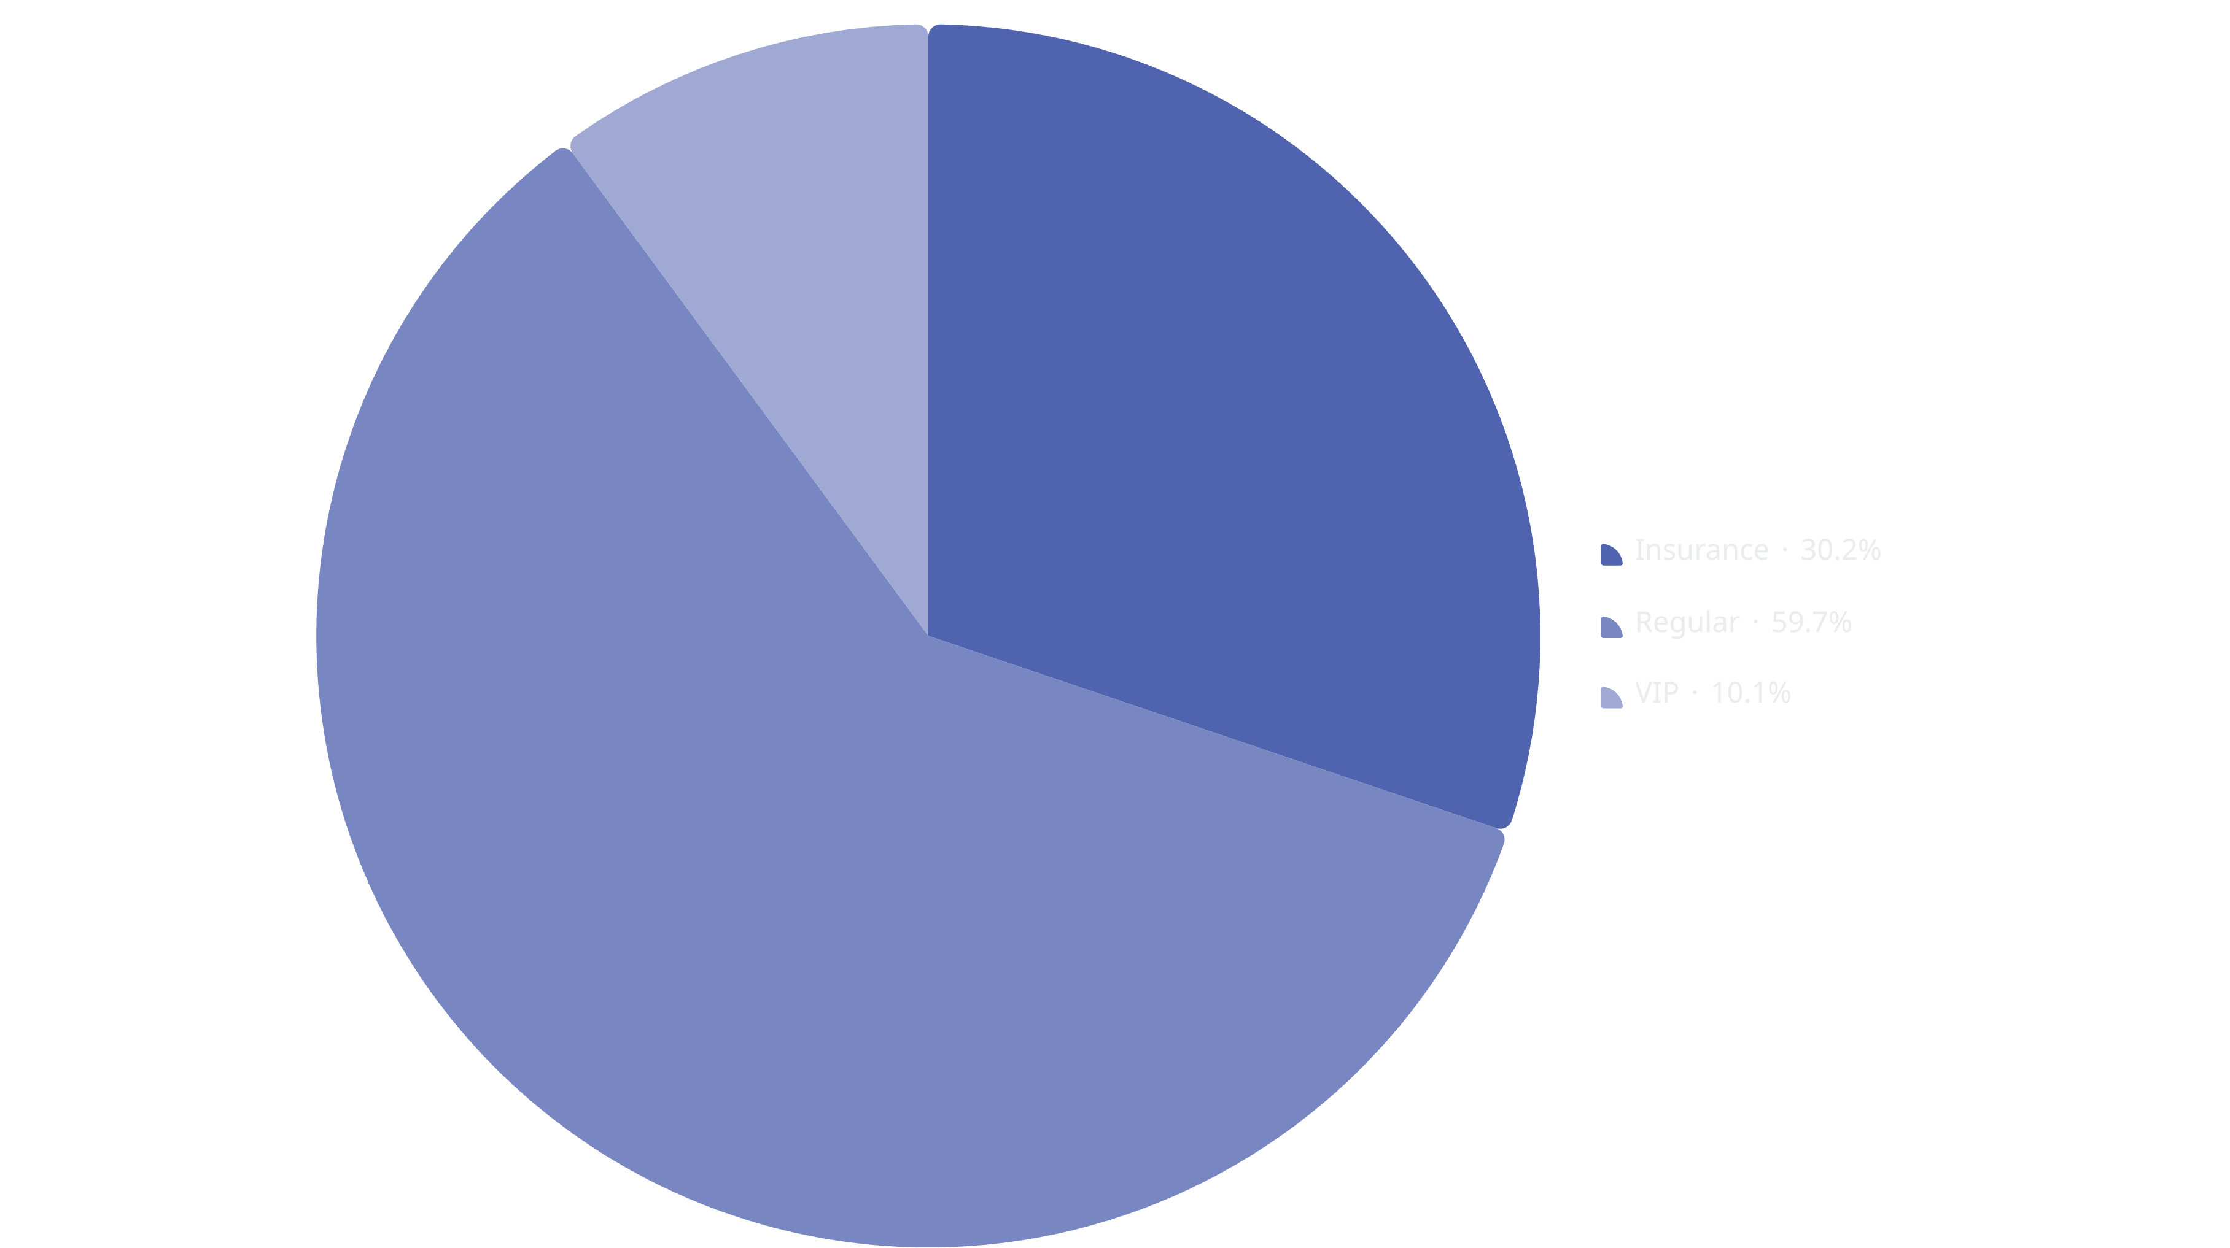
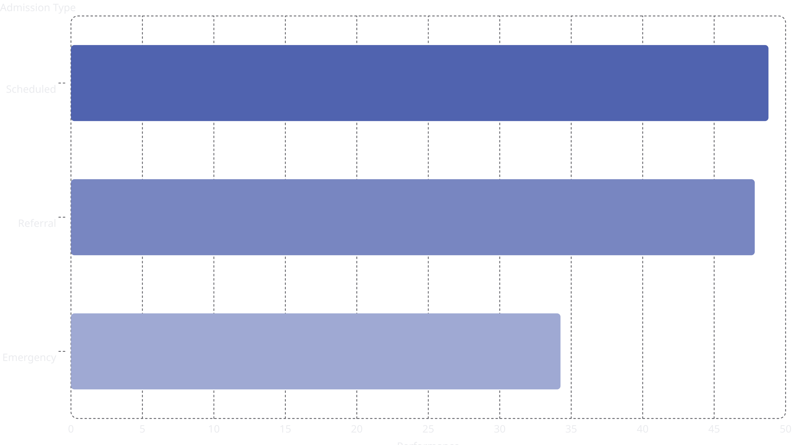
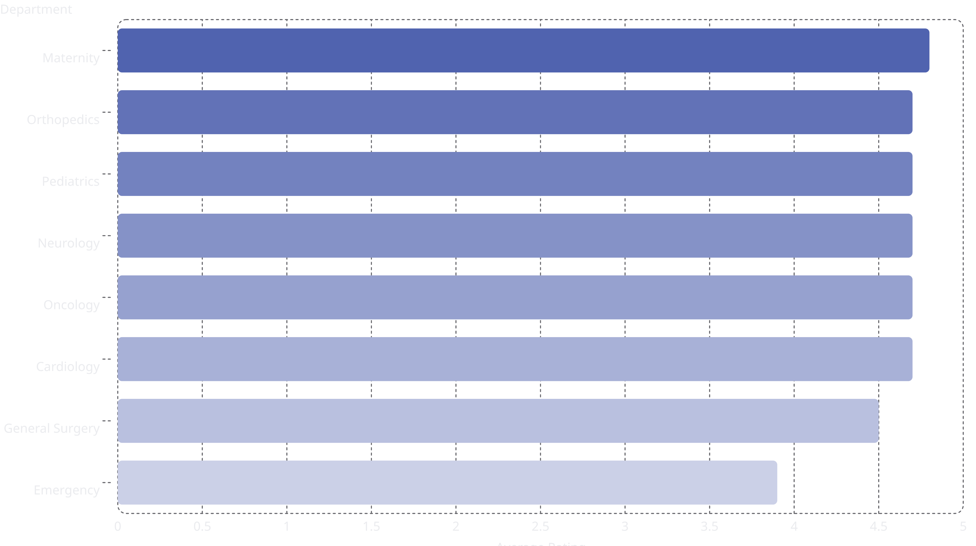
Power BI: Dashboard 3 - Performance Metrics
Key Metrics Displayed:
43.89
2225
Average NPS Score
Total Complaints
35
4.53
Average Waiting Time
Average Doctor Rating
minutes
/5
Visualizations:
The pie chart illustrates the distribution of patients across different insurance types, with Regular patients forming the largest segment.
This bar chart compares performance by admission type, showing Scheduled and Referral admissions having higher performance scores than Emergency admissions.
The horizontal bar chart displays the average rating by department, highlighting Maternity as the highest-rated and Emergency as the lowest-rated.
Profit by Admission Type (Pie Chart): Emergency, Referral, Scheduled distribution
Patients by Visit Channel (Bar Chart): Walk-in, Call/Checkin, Referral/Walk-in, Mobile/Walk-in, Website
Waiting Time Distribution (Histogram): Shows distribution of waiting times across all patients
Filters Available:
Patient Segment (Insurance, Regular, VIP)
Hospital Branch (Central, East, North, South, West)
Year (2024, 2025)
[Power BI Dashboard 3 - Performance Metrics]

Slide 27
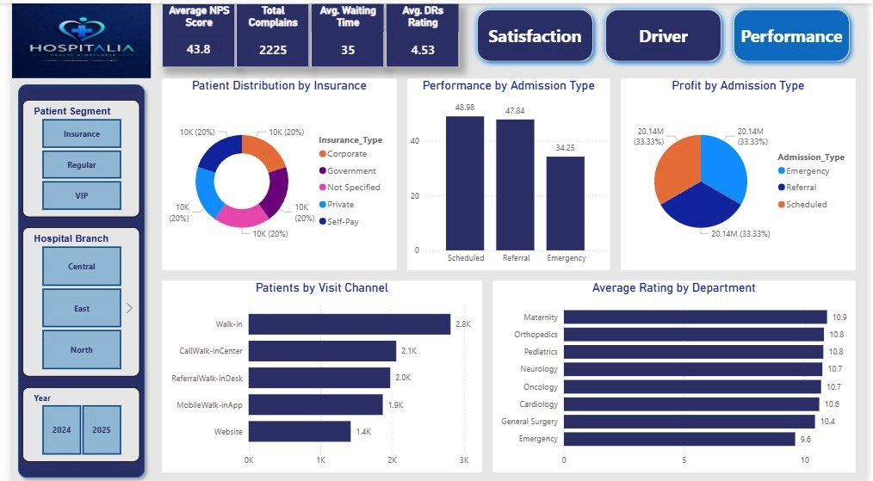

Slide 28
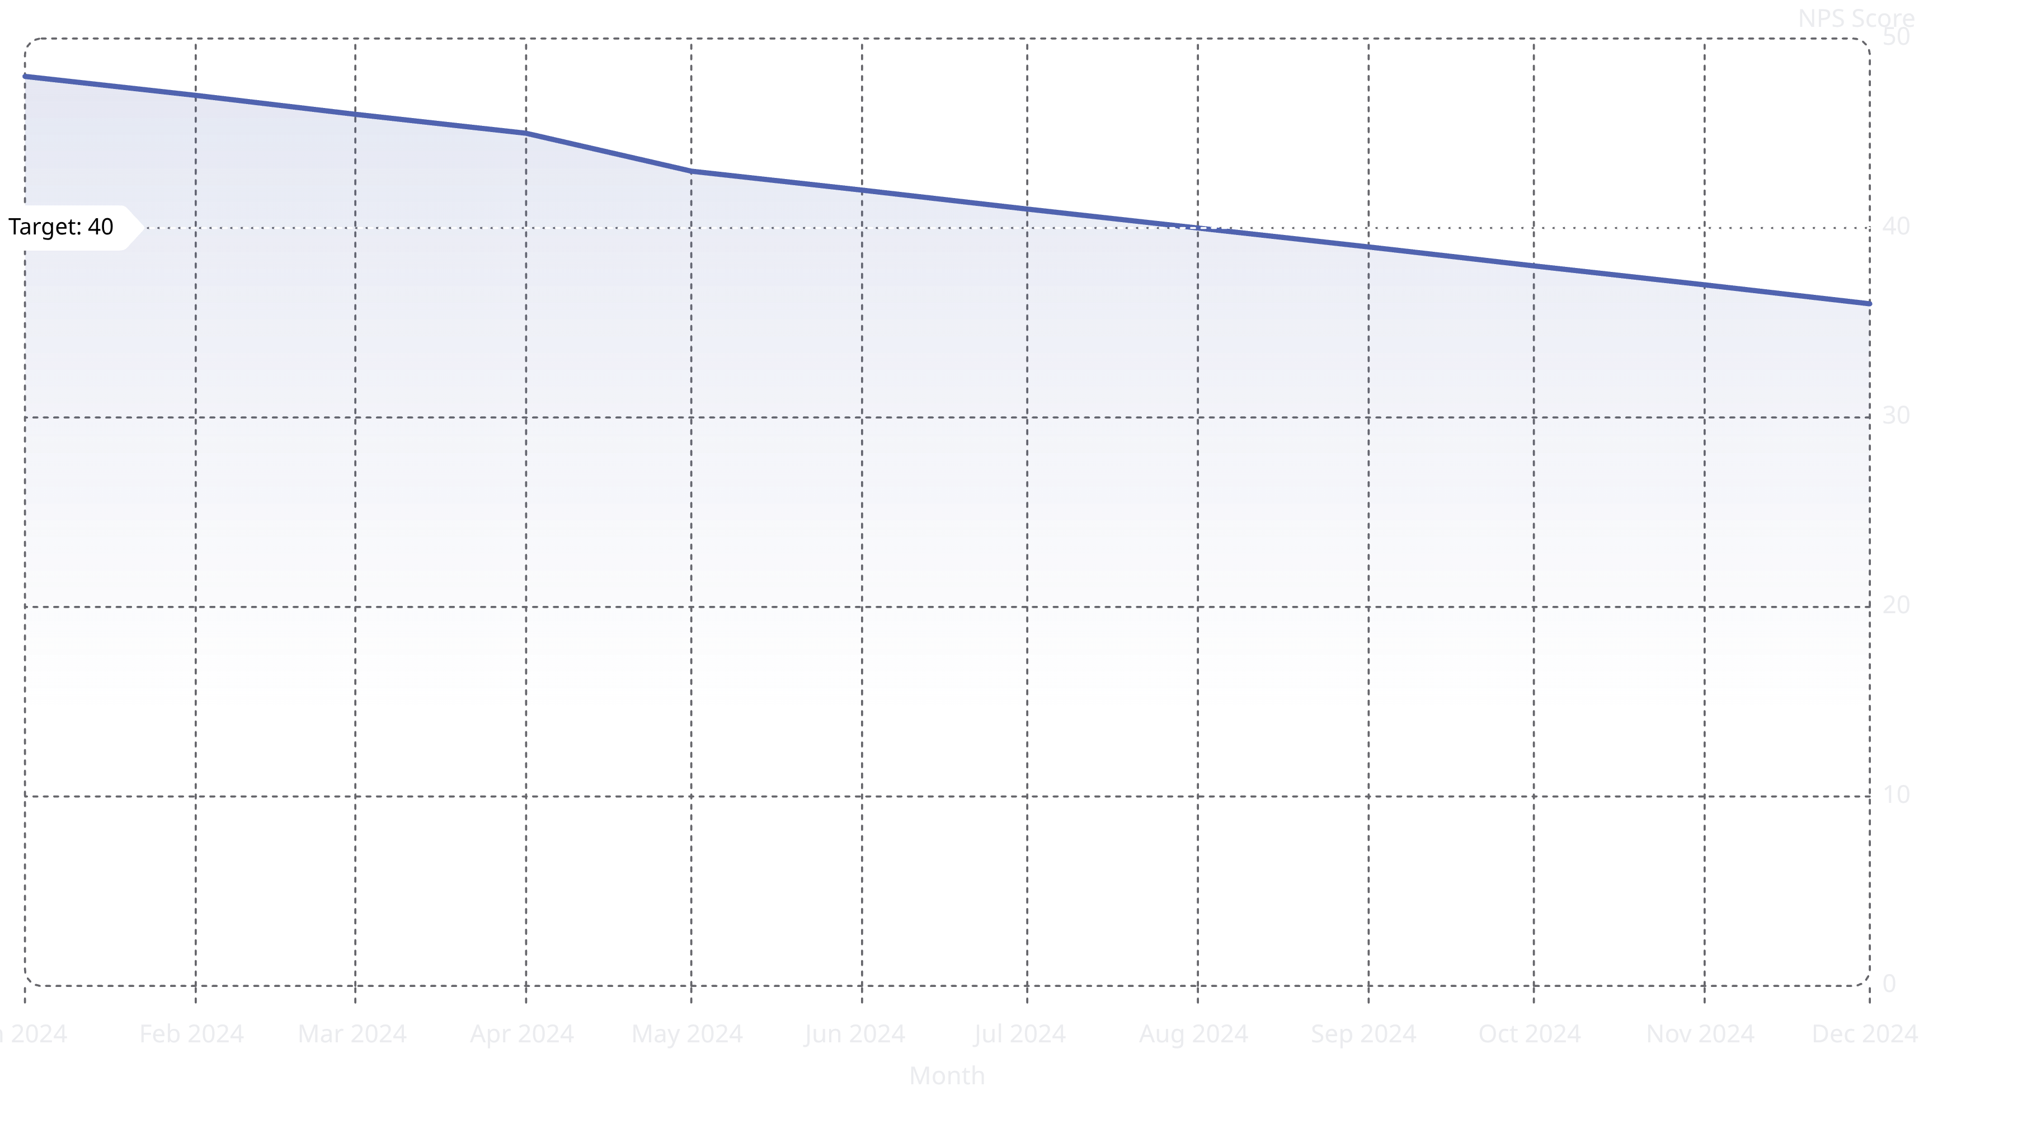
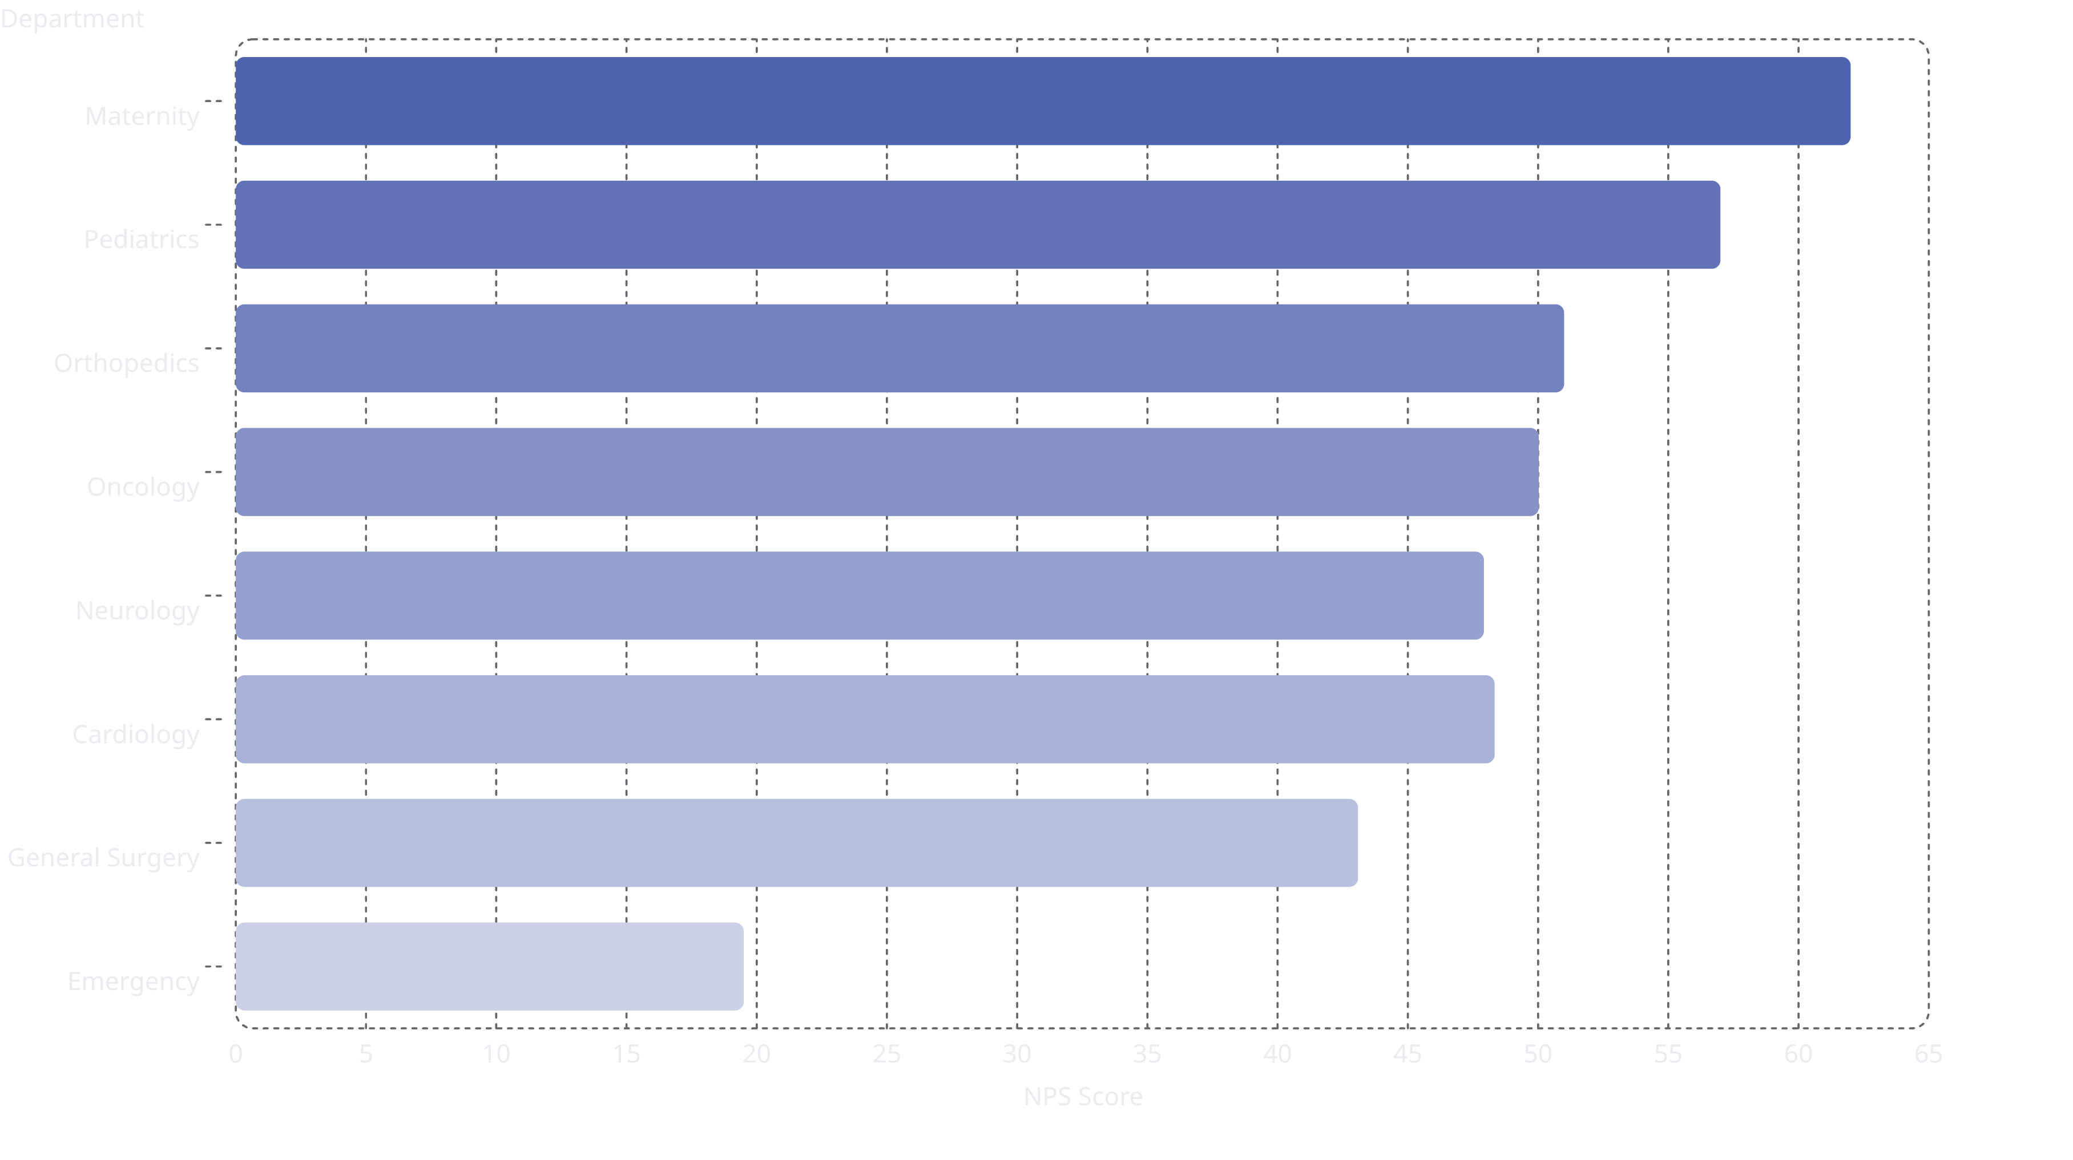
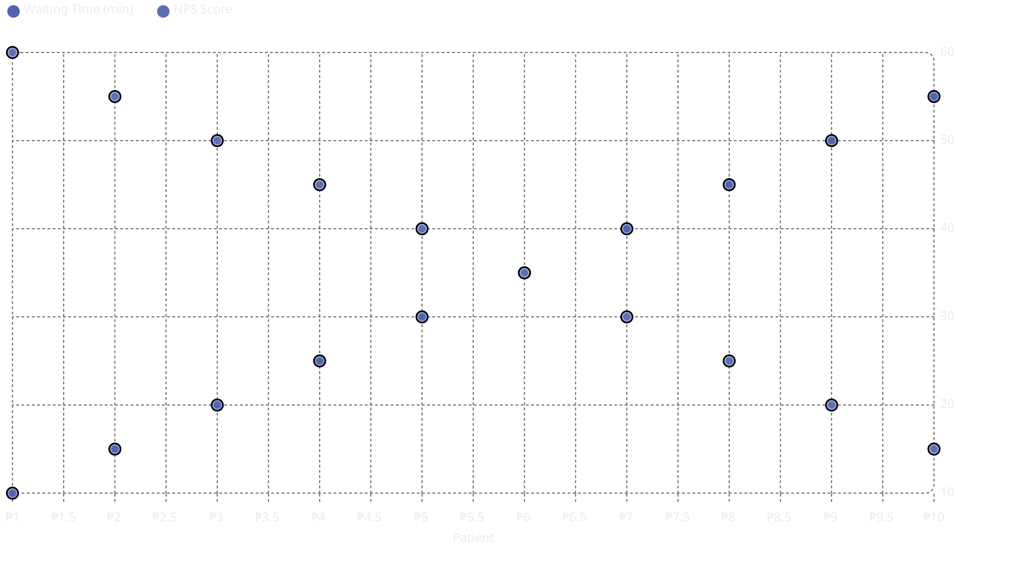
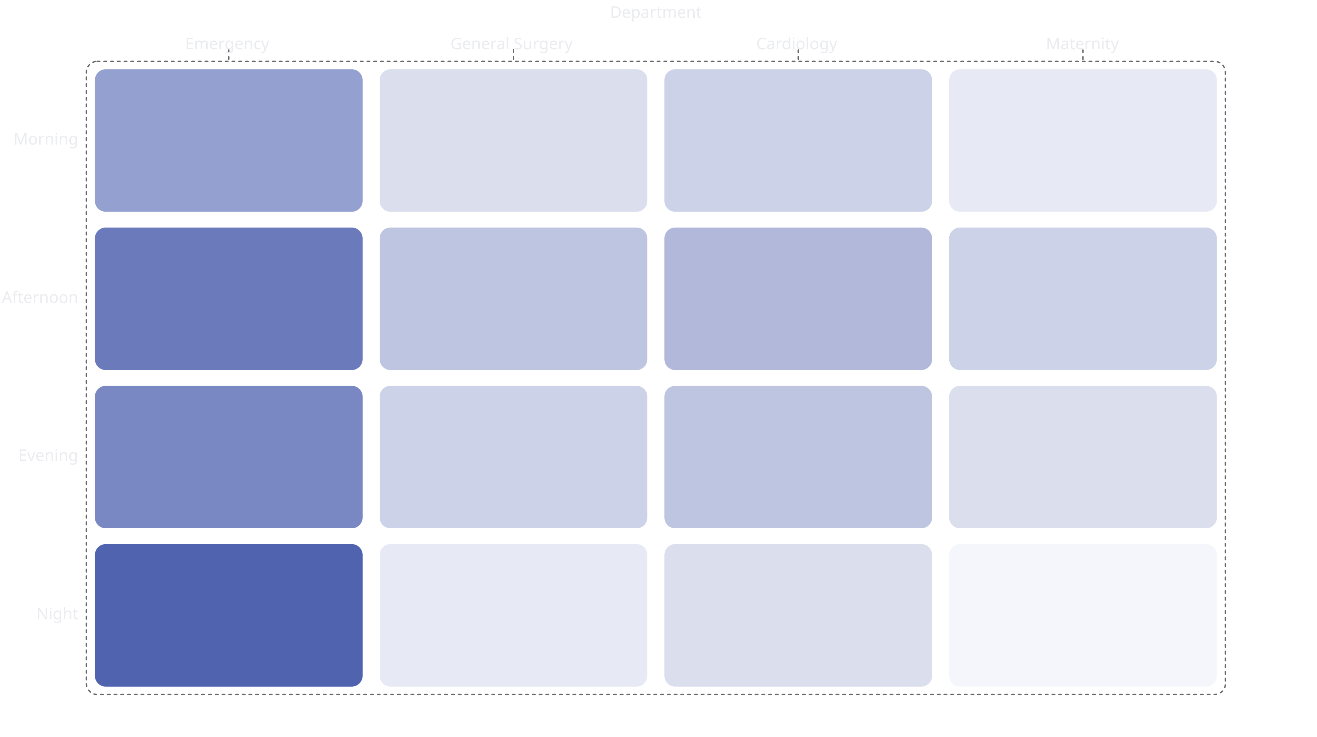
Tableau: Dashboard 1 - Patient Experience Overview
Key Metrics Displayed:
43.8
$2.0K
Average NPS Score
Average Profit
35
10K
Average Waiting Time
Total Patients
minutes
Visualizations:
1. The line chart illustrates the monthly NPS trend from 2024, showing a decline over the year, indicating a potential decrease in patient satisfaction.
2. This bar chart compares NPS scores across various departments, highlighting Maternity with the highest score and Emergency with the lowest, indicating areas for improvement.
3. The scatter plot visualizes the strong negative correlation between waiting time and NPS, indicating that longer wait times are associated with lower patient satisfaction.
4. This heatmap shows waiting times by department across different times of day, clearly indicating Emergency as a critical bottleneck, especially during night hours.
Waiting Time vs Branches (Bar Chart): North (35.9), Central (35.8), West (35.5), East (35.0), South (34.5)
Overall Rating vs NPS by Branch (Scatter): Shows correlation between satisfaction metrics
Filters Available:
Patient Segment (Insurance, Regular, VIP)
Hospital Branch (Central, East, North, South, West)
Year (2024, 2025)
[Tableau Dashboard 1 - Patient Experience Overview]

Slide 29
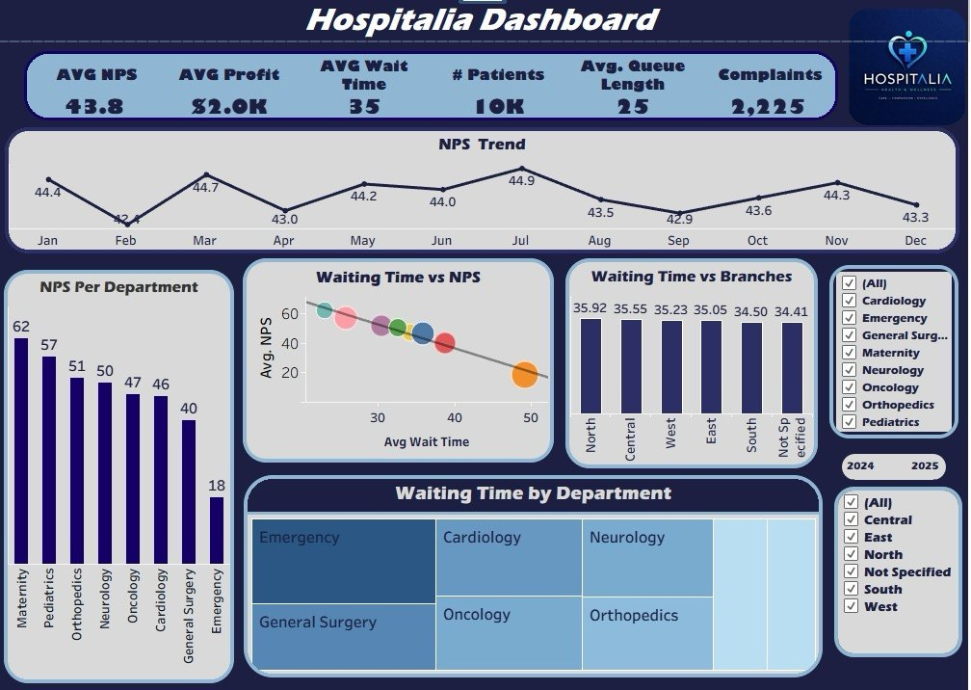

Slide 30
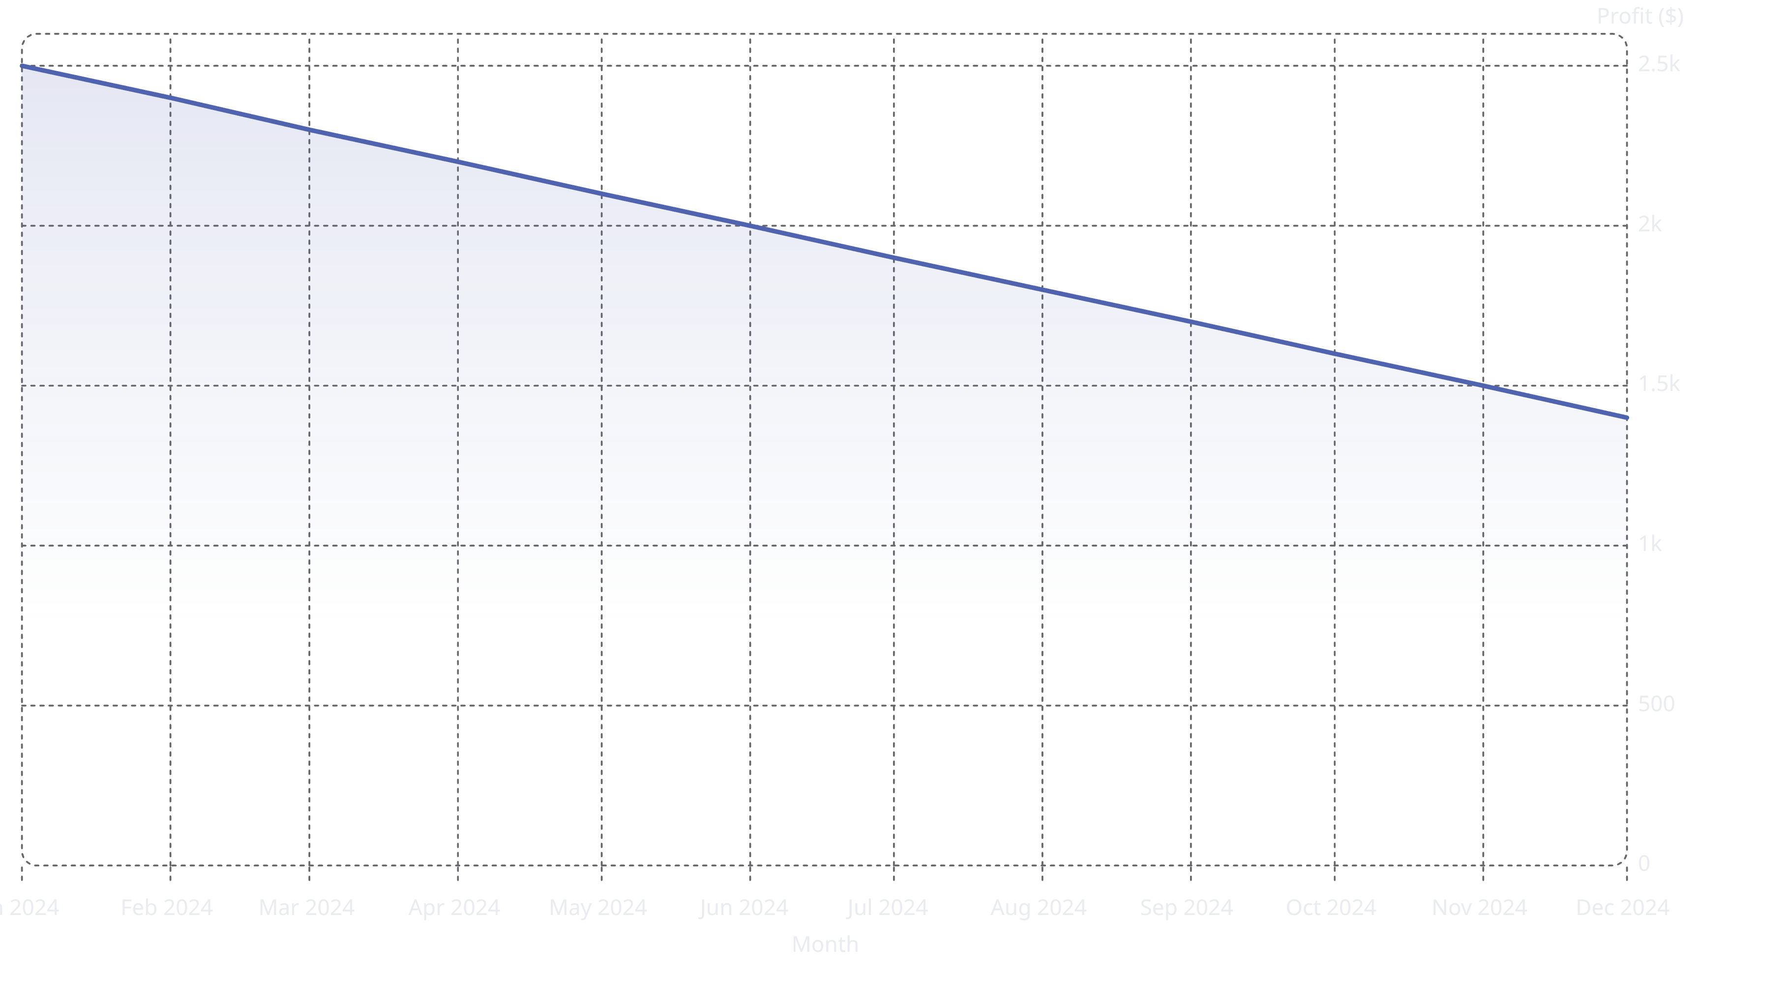
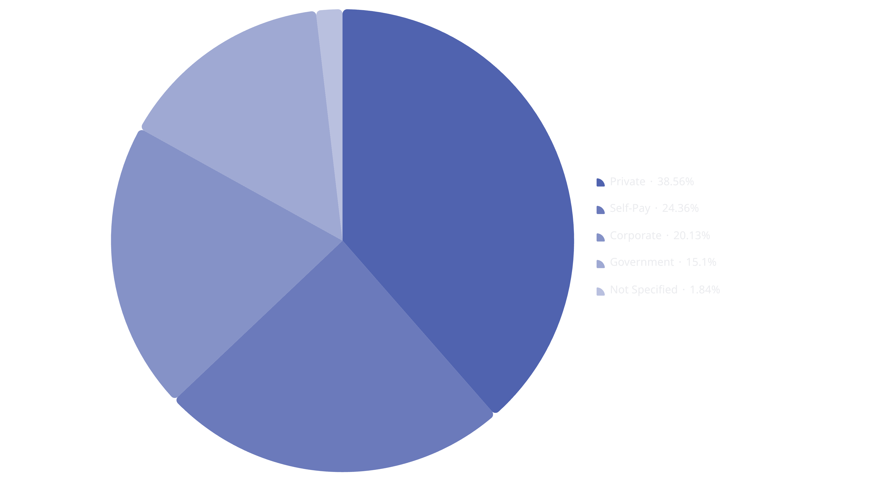
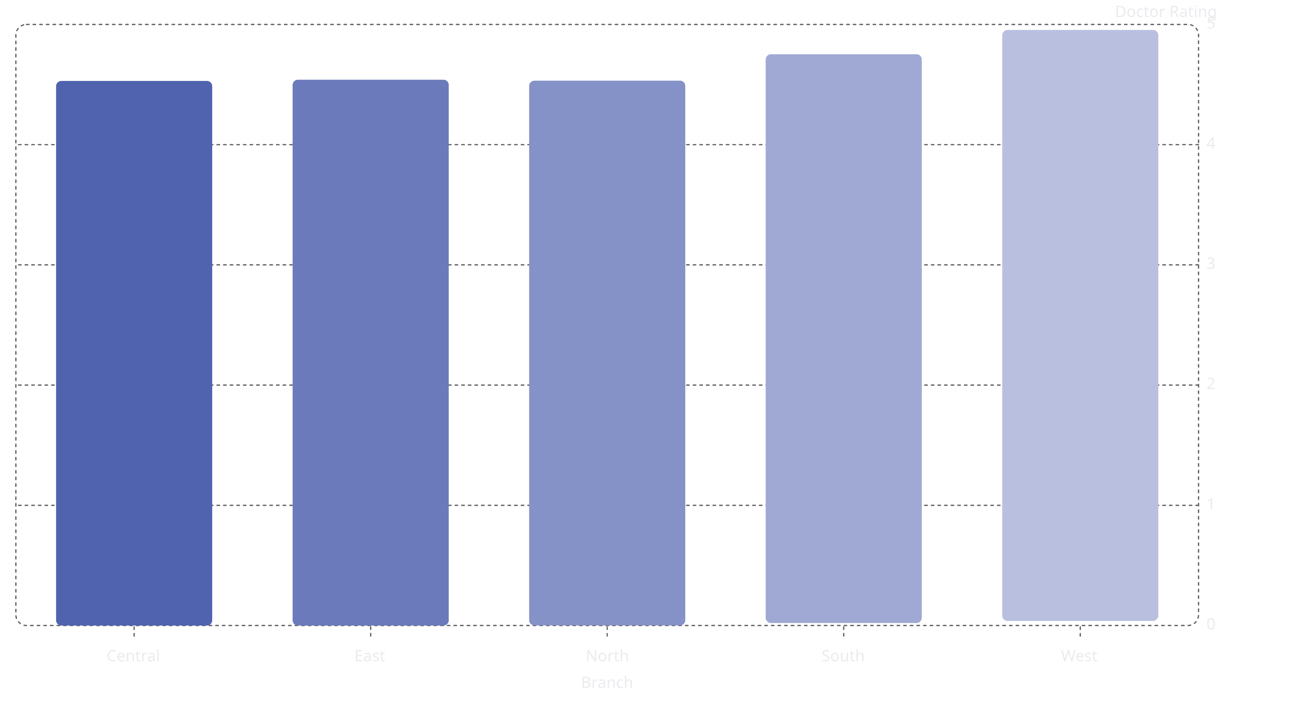
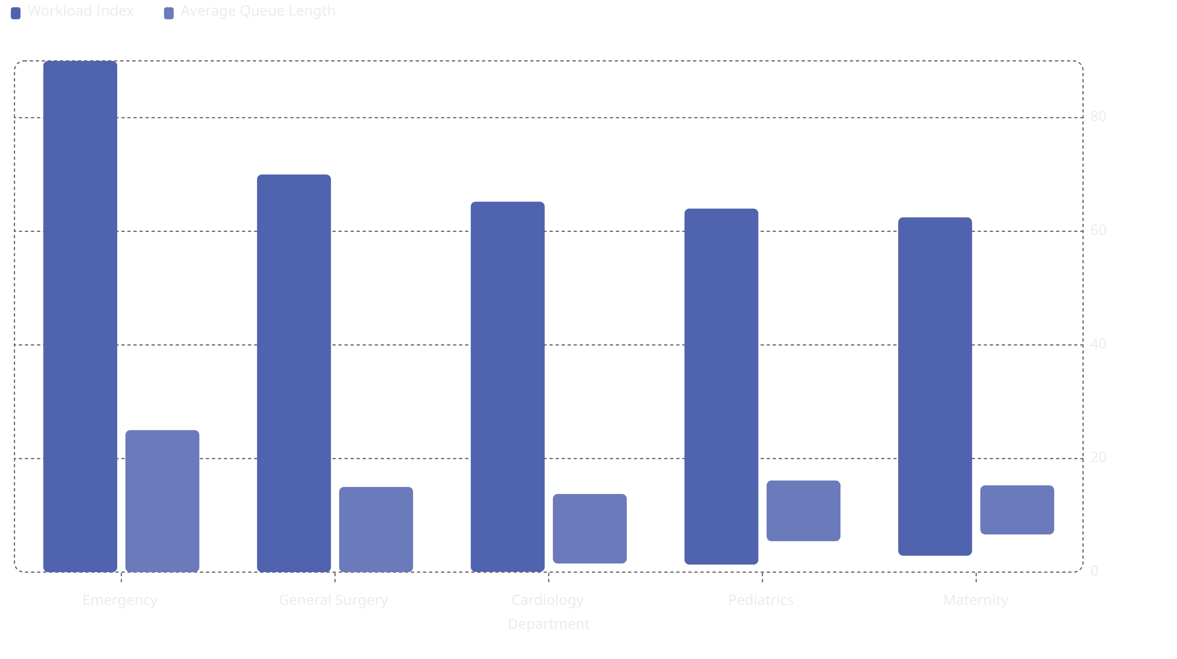
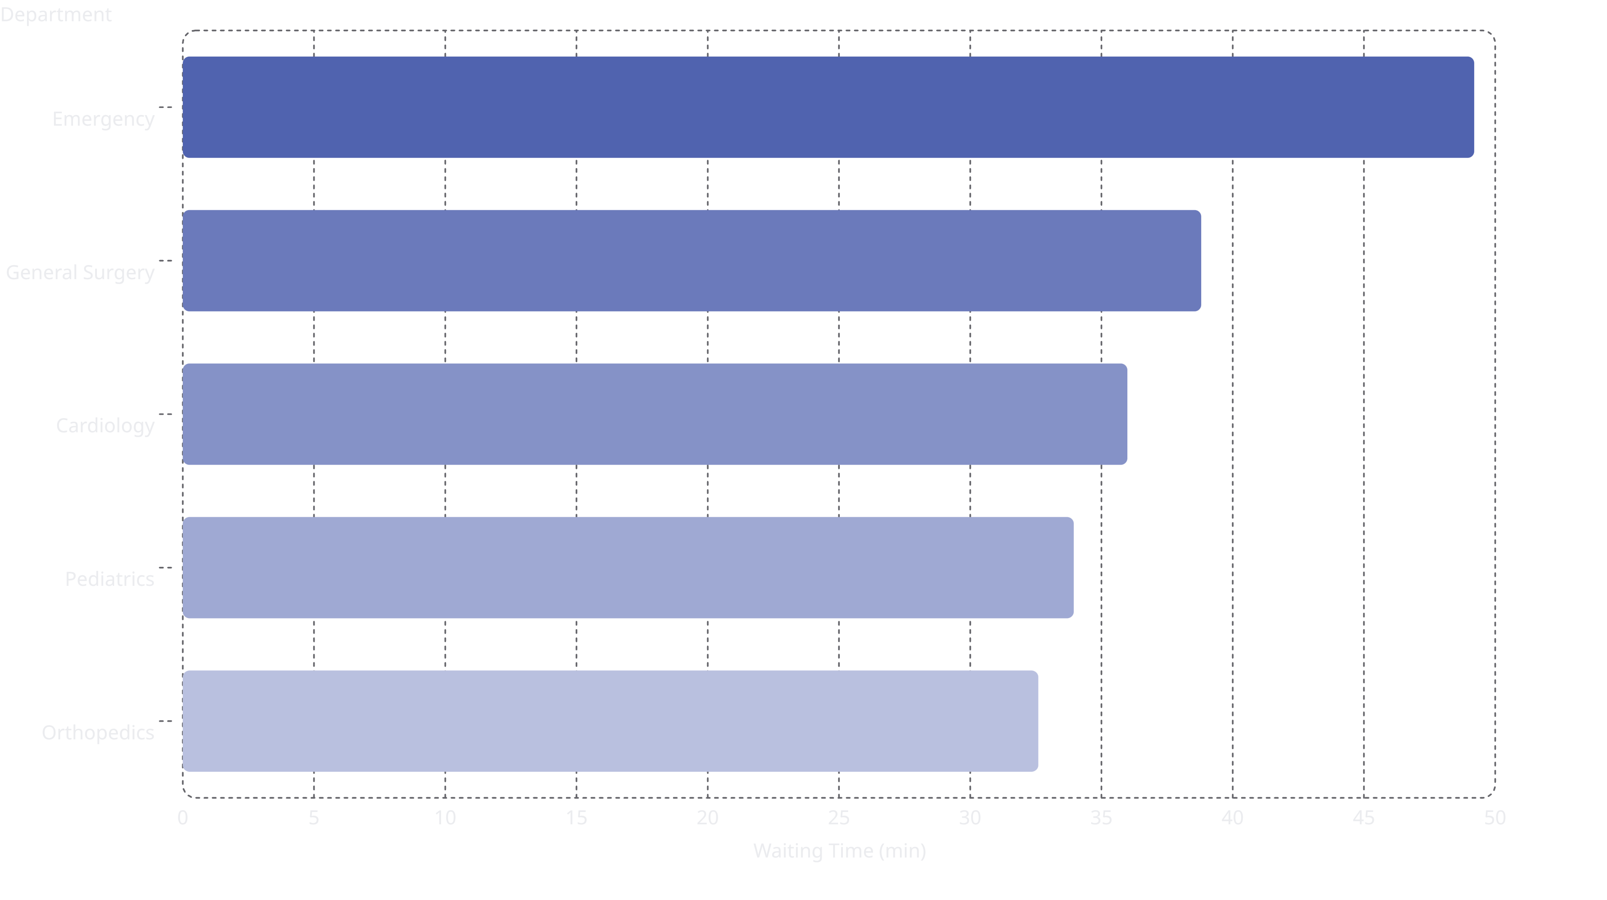
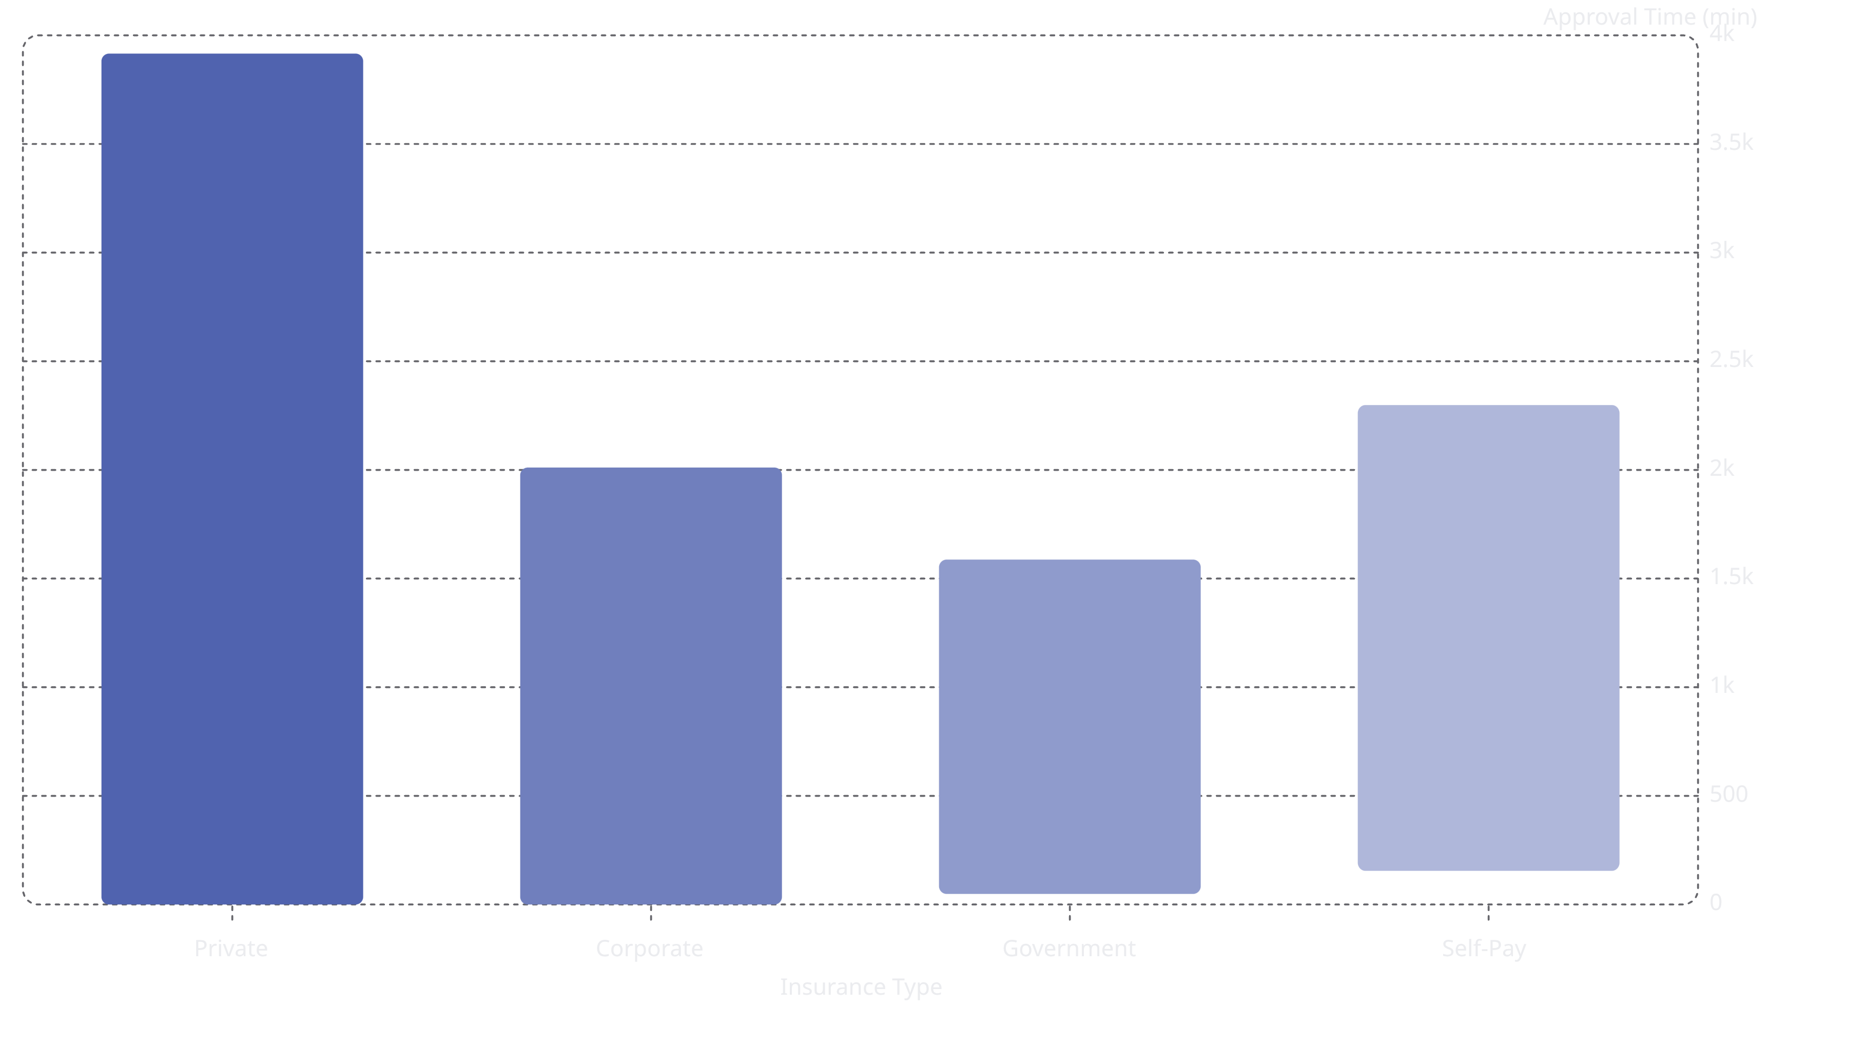
Tableau: Dashboard 2 - Operational Efficiency & Profitability
Key Metrics Displayed:
43.8
$2.0K
Average NPS Score
Average Profit
35
2,225
Average Waiting Time
Total Complaints
minutes
Visualizations:
1. Profit Trend (Line Chart): Monthly profit from 2024-2025 showing correlation with NPS decline
The line chart displays the monthly profit trend, showing a steady decline throughout 2024. This trend correlates with the observed NPS decline in patient satisfaction, suggesting a potential link between operational efficiency and financial outcomes.
2. Complaints vs Insurance Type (Pie Chart): Private (858), Self-Pay (542), Corporate (448), Government (336), Not Specified (41)
This pie chart shows the distribution of complaints based on insurance type, clearly indicating that Private insurance patients account for the largest share of complaints.
3. Doctor Rating vs Branches (Bar Chart): Shows consistent quality across branches (4.52-4.54)
The bar chart illustrates doctor ratings across different branches, demonstrating a consistent level of quality with ratings ranging from 4.52 to 4.54, indicating uniform doctor performance.
4. Doctor Workload vs Queue Length (Grouped Bar): Emergency department has highest combined workload
This grouped bar chart compares doctor workload and average queue length across departments, highlighting that the Emergency department consistently exhibits the highest combined workload and queue length.
5. Waiting Time vs Department (Horizontal Bar): Emergency (49.2), General Surgery (38.8), Cardiology (35.9), etc.
This horizontal bar chart displays average waiting times by department, clearly showing Emergency with the longest waiting times, followed by General Surgery and Cardiology.
6. Insurance Approval Time Comparison (Bar Chart): Private (3916 min), Corporate (2011 min), Government (1509 min), Self-Pay (1990 min)
The bar chart compares insurance approval times, revealing that Private insurance requires significantly longer approval periods compared to other types.
Filters Available:
Patient Segment (Insurance, Regular, VIP)
Hospital Branch (Central, East, North, South, West)
Year (2024, 2025)
[Tableau Dashboard 2 - Operational Efficiency & Profitability]

Slide 31
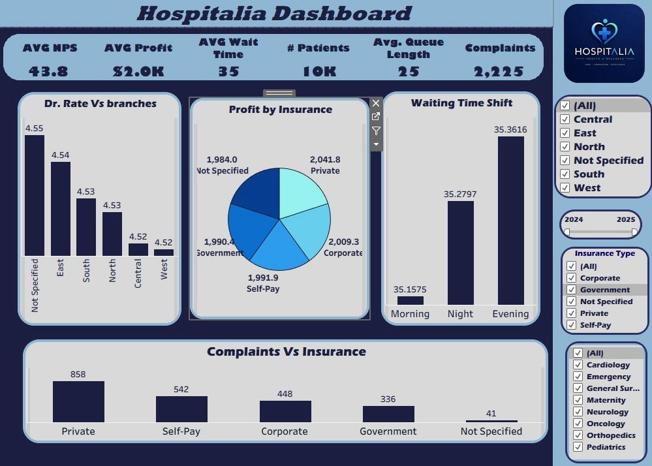

Slide 32

Final Insights & Recommendations
Operational Insights:
Key Drivers Behind Low NPS:
Long waiting times (avg 35.25 min, Emergency 49.2 min)
Delayed appointments (avg 18.64 min)
Lower service ratings (avg 3.75/5)
Staff interaction issues
Increased complaints (2,225 total)
Overloaded queues (avg 24.51 patients)
Business Impact:
Reduced patient satisfaction (NPS 43.87)
Increased dissatisfaction risk
Reduced patient loyalty
Contributed to lower profitability (profit decline 0.8%)
Recommendations:
How Can the Hospital Improve NPS?
01
02
Reduce waiting times (target: <35 min for all departments)
Improve appointment scheduling efficiency
03
04
Increase staff responsiveness
Monitor complaints in real time
05
06
Improve service quality standards
Optimize queue management
07
Benchmark low-performing branches against top-performing branches (South: 45.05 NPS)
Expected Business Impact:
Increase patient retention
Improve hospital reputation
Increase revisit rate
Improve long-term profitability
Final Conclusion:
Final Business Story:
The analysis confirmed that:
NPS decline was not random
Operational inefficiencies directly impacted patient satisfaction
Lower patient satisfaction contributed to declining profitability
Final Takeaway:
"Better patient experience leads to stronger loyalty, stronger retention, and higher profitability."

Slide 33

Thank You
HOSPITALIA Health & Wellness - Patient Experience Analytics Project
"Data-Driven Insights for Better Patient Care and Profitability"
Project Team:
Prepared by:
Amr Zaki (Data Cleaning & Modeling, SQL, Power BI)
Omnia Magdy (Tableau Dashboards & Presentation)
Rawan Mahmoud (Data Analysis, Excel Dashboard, Python, Documentation)
Fatma Ali (Excel Statistics & Descriptive Analysis, Power BI)
Mostafa Samir (Insights Support)
Dr. Amal Mahmoud
Academic Year:
2024-2025
Care · Compassion · Excellence

